Slide 1

Computer Network and IoT
Introduction to Terminologies of Computer Network Part - 01
By: Pankaj Mishra
Assistant Professor
Dept. of CSE/IT
JIIT, Noida

Slide 2
Content
Data Communication
Components of Communication
Data Flow Mode
Network
Network Criteria
Delays in Network

Slide 3
Data Communication
When we communicate, we are sharing information. This sharing can be local or remote. Local communication usually occurs face to face, while remote communication takes place over distance. The term telecommunication, which includes telephony, telegraphy, and television, means communication at a distance (tele is Greek for "far").
Data communications are the exchange of data between two devices via some form of transmission medium such as a wire cable.
The effectiveness of a data communications system depends on four fundamental characteristics:

Slide 4
Delivery. The system must deliver data to the correct destination. Data must be received by the intended device or user and only by that device or user.
Accuracy. The system must deliver the data accurately. Data that have been altered in transmission and left uncorrected are unusable.
Timeliness. The system must deliver data in a timely manner. Data delivered late are useless. In the case of video and audio, timely delivery means delivering data as they are produced, in the same order that they are produced, and without significant delay. This kind of delivery is called real-time transmission.

Slide 5
4. Jitter. Jitter refers to the variation in the packet arrival time. It is the uneven delay in the delivery of audio or video packets. For example, let us assume that video packets are sent every 30 ms. If some of the packets arrive with 30 ms delay and others with 40 ms delay, an uneven quality in the video is the result.

Slide 6
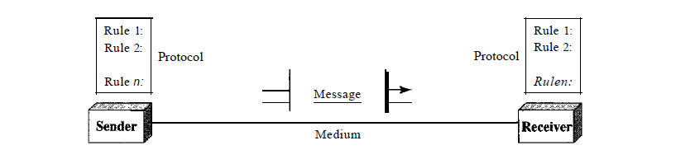
Components of Communication
A data communications system has five components

Slide 7
Message. The message is the information (data) to be communicated. Popular forms of information include text, numbers, pictures, audio, and video.
Sender. The sender is the device that sends the data message. It can be a computer, workstation, telephone handset, video camera, and so on.
Receiver. The receiver is the device that receives the message. It can be a computer, workstation, telephone handset, television, and so on.
Transmission medium. The transmission medium is the physical path by which a message travels from sender to receiver. Some examples of transmission media include twisted-pair wire, coaxial cable, fiber-optic cable, and radio waves.
Protocol. A protocol is a set of rules that govern data communications. It represents an agreement between the communicating devices.

Slide 8
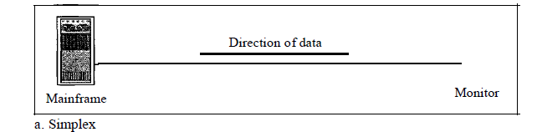
Data Flow Mode
Communication between two devices can be simplex, half-duplex, or full-duplex.
Simplex
In simplex mode, the communication is unidirectional, as on a one-way street. Only one of the two devices on a link can transmit; the other can only receive .
Keyboards and traditional monitors are examples of simplex devices. The keyboard can only introduce input; the monitor can only accept output.

Slide 9
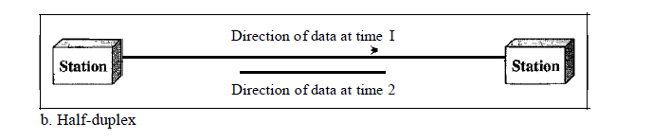
Half-Duplex
In half-duplex mode, each station can both transmit and receive, but not at the same time. When one device is sending, the other can only receive, and vice versa.
The half-duplex mode is like a one-lane road with traffic allowed in both directions.
Walkie-talkies and CB (citizens band) radios are both half-duplex systems.

Slide 10
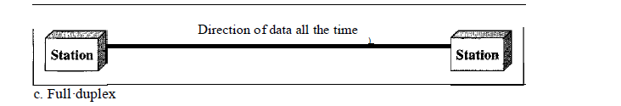
Full-Duplex
In full-duplex mode (also called duplex), both stations can transmit and receive simultaneously.
The full-duplex mode is like a two-way street with traffic flowing in both directions at the same time.
One common example of full-duplex communication is the telephone network. When two people are communicating by a telephone line, both can talk and listen at the same time.

Slide 11
Network
A network is a set of devices (often referred to as nodes) connected by communication
links. A node can be a computer, printer, or any other device capable of sending and/or
receiving data generated by other nodes on the network.

Slide 12
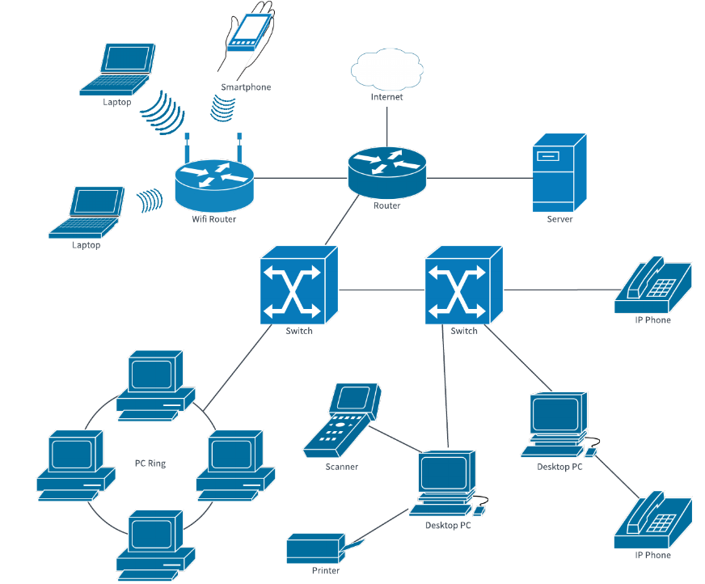

Slide 13
Network Criteria
A network must be able to meet a certain number of criteria. The most important of these are performance, reliability, and security.
Performance
Performance can be measured in many ways, including transit time and response time.Transit time is the amount of time required for a message to travel from one device to another. Response time is the elapsed time between an inquiry and a response.
The performance of a network depends on a number of factors, including the number of users, the type of transmission medium, the capabilities of the connected hardware, and the efficiency of the software.

Slide 14
Reliability
In addition to accuracy of delivery, network reliability is measured by the frequency of failure, the time it takes a link to recover from a failure, and the network's robustness in a catastrophe.
Security
Network security issues include protecting data from unauthorized access, protecting data from damage and development, and implementing policies and procedures for recovery from breaches and data losses.

Slide 15
Delays in Network
1. Transmission Delay:
The time taken to transmit a packet from the host to the transmission medium is called Transmission delay.
Let B bps is the bandwidth and L bit is the size of the data then transmission delay is,
Tt = L/B

Slide 16
2. Propagation delay:
After the packet is transmitted to the transmission medium, it has to go through the medium to reach the destination. Hence the time taken by the last bit of the packet to reach the destination is called propagation delay.
Tp = Distance / Velocity

Slide 17
3. Queueing delay:
Let the packet is received by the destination, the packet will not be processed by the destination immediately. It has to wait in a queue in something called a buffer. So the amount of time it waits in queue before being processed is called queueing delay.
In general, we can’t calculate queueing delay because we don’t have any formula for that.
This delay depends upon the following factors:
If the size of the queue is large, the queuing delay will be huge. If the queue is empty there will be less or no delay.
If more packets are arriving in a short or no time interval, queuing delay will be large.
The less the number of servers/links, the greater is the queuing delay.

Slide 18
4. Processing delay:
Now the packet will be taken for the processing which is called processing delay.
Time is taken to process the data packet by the processor that is the time required by intermediate routers to decide where to forward the packet, update TTL, perform header checksum calculations.
It also doesn’t have any formula since it depends upon the speed of the processor and the speed of the processor varies from computer to computer.
NOTE
Ttotal = Tt + Tp + Tq + Tpro

Slide 19
Thank You

